Slide 1
Target Markets
Or who are our ideal students?

Slide 2
Target markets
‘[A] Target market is the end consumer to which the company wants to sell its end products to.’
- Economic Times, Link
Who are our ideal students / customers?
What problems / needs are we solving for them?

Slide 3
Why have target markets / what do we get
Why?
What do we get?
Where to focus and how to sequence
Allows us to know our students –
Do we have product – market fit? Are we tailoring to the intended audience? Who is the intended audience? Do students receive intended value?
Allows us to easily identify constituents, players, needs, and trends in each field of play
i.e. who are competitors, who are partners, what are distribution options / levers
A competitor in one field may be a critical partner in another
Enables storytelling
Alleviate a pain point for front-line individuals
Provide consistent information / shared language for all (faculty, staff, students, etc.)
Setup for strategic decision-making
Necessary for the effective sequencing and prioritization of distribution, sales, marketing, and personalization tactics
Loose alignment
Ability to assess effectiveness in our markets,
Necessary step to calculating Share of Wallet, Market Share, Revenue Opportunity, long term RoI estimates, individual propensity to purchase, etc.

Slide 4
Markets
Note: Typically, as addressable market size grows, profitability per individual (or unit) drops.
For instance, Consumer Education is ‘free’ or loss-leading while some core designations have high margins.
However, with certain programs and markets (i.e. CAP / Nonprofit), the targeted fit may allow unit profitability to rise first; then drop off as normal.
Addressable Markets
Mass appeal
Broad
High-level markets
Rough market size*
Learners / Consumers
? (.5M – 5M – 15M+)
Adjacent
Financial Services
? (~6M)
Wealth Mgmt / Nonprofit / etc.
~500k-700K / ? / 1M+
Core
Life Insurance
~1.4 M, but declining
*Market size is not representative of current revenue opportunity

Slide 5
Draft Target Markets
Life Insurance firms / individuals (both captive BD, and noncaptive)
Including the Carrier / Agent model
Wealth Management firms / individuals (as denoted in the Cerulli Reports)
RIA, BD, Bank BD, Private Bank /Trust, Wirehouse, TPMs, TAMPs, similar
Client facing, Client support, other Mid/Back office individuals
Team structured individuals (i.e.. specialists on Teams in an advisory practice)
Non-professionals interested in furthering their education
Individuals who self-manage their assets
Professionals in adjacent business with an affinity group (special needs, nonprofit / philanthropy)
Professionals in adjacent business without an affinity group (tax / estate / CPAs / lawyers)
Paralegals (ie supporting accounting work), teams
Individuals seeking CE (?)
Relevant affinity groups / Communities (Alumni, special needs, nonprofit / philanthropy, retirement, women in financial services, ethics, etc.)
Consumers through the Financial Literacy program
Executives / leaders in Financial Services (BELP, Ethics, etc.)
Just In Time learning targets
Individuals who consume Thought Leadership / Research
Notes:
Paralegal note within Fuse research; support functions for tax / planning / trust / estate – paralegal with accounting work for tax law

Slide 6
Next Steps / What does success look like?
Draft of Target Markets (written down)
Gather input / feedback (~3 meetings and a survey)
Especially: Marketing, Business Development, Centers, and (ideally) Faculty/Program Directors
Loose alignment around a working draft of our target markets
Success is a written down working draft of our target markets
We will share an interpretation / definition guide alongside
This can then be used with Student Profiles, persona development, personalization, etc.

Slide 7
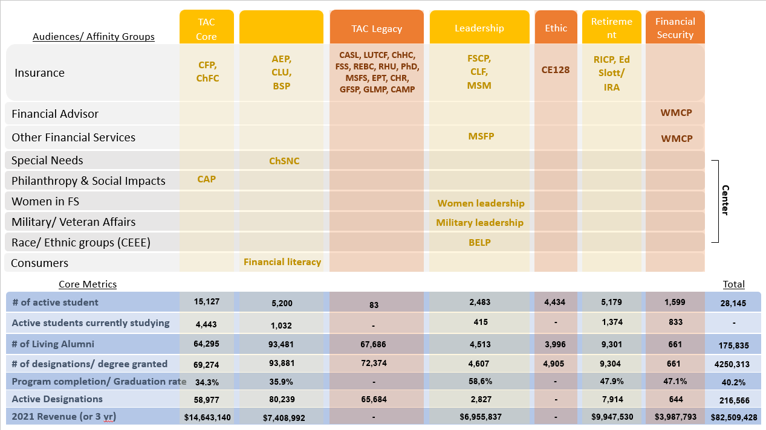
Sample mapping
Draft
This is directional data based on a first draft of Offer mapping from early 2022.

Slide 8
Appendix

Slide 9
Working session questions (if time permits)
Company view:
Industry
Business line(s)
Captive / non-captive
Revenue size
Existing relationship
Number of employees
Company’s customer base
Number and type
Brand / Credibility
Strategic alignment / fields of play / vision
Individual view:
Job / Profession?
Revenue / income level
Role / domain
Years of experience
Age / Life event?
Previous Education / Degrees?
Geography / Location
Demographics?
Pain points / Needs / Goals
Ethics / complaints / reputation

Slide 10
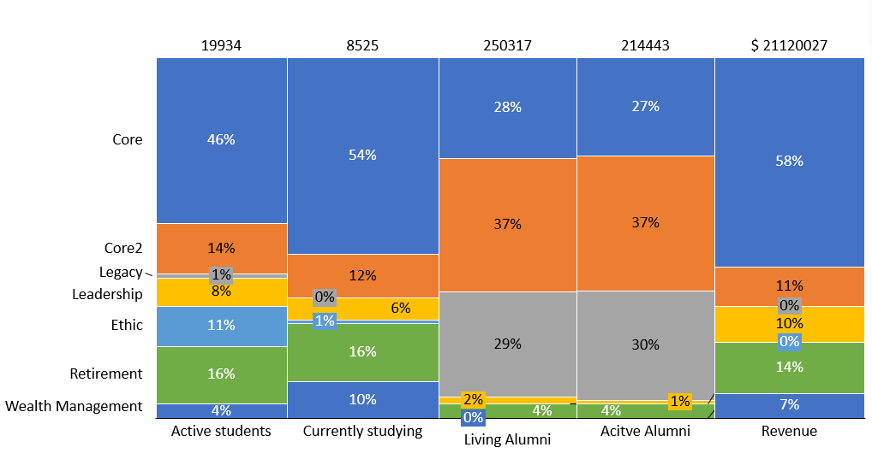
DRAFT: Institutional view of offers
This is directional data based on a first draft of Offer mapping from early 2022. Use for illustrative purposes only.
Draft – Illustrative purposes

Slide 11
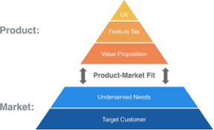
A look forward: Mapping students to offers is a key step towards personalization
A path towards personalization
Product-Market Fit
Loose Target Markets / Ideal Students
Initial Student Profiles (including by offers)
Draft of Offers mapped to educational spaces
Ideal Customer Profiles and/or Initial personas
Fill in missing data along the student journey
Operationalize personas through push & pull demand generation
Notes:
The ideal customer profile (ICP) defines the firmographic, environmental and behavioral attributes of accounts that are expected to become a company’s most valuable customers. It is developed through both qualitative and quantitative analyses, and may optionally be informed by predictive analytics software.
Unlike the term “target customer,” which is often used to describe any company that might buy a product or service, the ICP is focused on the most valuable customers and prospects that are also most likely to buy. The ICP should not be confused with the total addressable market or total available market, which are calculations or estimates of the universe of potential target customers.

Slide 12
Some leading questions to address From ‘the RICP Experiment Whitepaper’
Could I get a clear developed database of the [RICP] opportunity in terms of its product-market fit? How do we identify the target market for various offers? How big are the insurance and advisory spaces? What do we think we could grow share to within each?
How can we better understand the needs, preferences, and value propositions of various sub-segments (i.e. individuals transitioning to be independent)?
For competing designations, how fast are they growing in the marketplace? What share do they have?
What other firms would align with us to grow the product? How big are they? What market share do we have within each firm? Why are we successful in some firms and not in others? Are there best practices we can share?
Outside of partnering with firms, what is the opportunity to grow through independent or small company advisors and agents? Is it even worth pursuing?

Slide 13
Reference: links
Videos:
Note: the HBS links may need sign-ins, please see the alternative video or transcripts as needed
Customer Centricity – overview of thinking: Ranjay Gulati, HBS
Alternative video, 2010
Customer Focus – data into value through alignment: Michael Schrage, MIT Sloan
Background articles:
These go into some depth, but are strong reference articles
Target Market, Investopedia overview article
Target Market Analysis, blog
Hubspot, Ideal Customer Persona & Buyer Personas
Ideal Customer Profile Development, Gartner blog post
Ideal Customer Profile, Crunchbase blog
Ideal Customer Profile, blog

Slide 14
Reference (cont.)
“I think what a lot of organizations that say they want to be data driven or algorithmically driven fundamentally misunderstand is the belief that if we know more about our customer, we can change their behavior or we can change our behavior to change their behavior. And that’s not the case at all. The key word when one talks about being data driven is alignment.
So, I’ve run into situations where you have call centers and contact centers, which do stress analysis of customer call voices or sentiment analysis of the chat exchanges that are going on. And guess what? The script for response doesn’t work. There’s no ability to elevate or escalate in a way to meet the needs of the customer or calm the customer down. The real challenge more often than not is not how do we get to know more about the customer faster; it’s do we have a process, a system, a person in place to take advantage of that knowledge and turn it into a problem resolution or a value-added engagement?”
Customer Focus – data into value through alignment: Michael Schrage, MIT Sloan

Slide 15
Reference (cont.)
“’Customer-centricity’ is one of those phrases that is used a lot in organizations. It’s kind of like what I call “happy talk,” or platitudes. And I think people talk about customers in [very loose terms]. I think that if you really want to take these ideas seriously, you have to engage in a very deep thought process, because customer engagement is not something like simply going to customers and asking them what they want. It’s much deeper than that.
I want to give an example to illustrate this idea. One of the best-selling products in the grocery store in the last many years is chopped, washed, bagged salad. We pay anywhere from $3.00 to $4.00 for these six-ounce bags. And what’s fascinating is that we’re willing to pay that money for something that we could buy ourselves for less than half that price. If you wanted to buy the ingredients, that will cost you much less. Why am I willing to pay so much? So it seems that—oh, you know what, convenience. Well, come on. Convenience? How long does it take to chop and wash salad? It takes couple of minutes. And we’re willing to pay a ton more for it.
And what is interesting is that if you look carefully at the product, [there are] many layers of value in this product. It stores easily—stack it up. It stays fresh longer. You can have variety, right? You don’t have wastage. It’s easier to shop for it. It’s convenient to serve healthy food without having to do all the hard work. What’s interesting is that, who came up with this idea? It’s unclear who actually came up with the idea. But I would venture—I doubt the lettuce companies came up with the idea. Because lettuce companies, the typical answer for the product companies is to go to the customer and ask them what—“Do you like my lettuce? Or do you like all my lettuce? How can make my lettuce better for you? Do you like the packaging of the lettuce?”
So when we engage with customers, we look at them through the lens of our product, not through what their needs are. And I think the biggest obstacle to this happening in organizations is to engage in this conversation, you have to start from a position of humility and curiosity. And, unfortunately, in large organizations, what we have is, humility turns into arrogance. And curiosity turns into blissful ignorance. And so when we do this customer stuff, all we do is the usual, do “Do you like me? What do you like about me? How can I make it better for you?”
If you’re going to do that, you’re never going to be able to break into the proverbial bagged salad idea. To get that, you have to have that curiosity and humility to really engage in a deep understanding of the marketplace. That’s what customer-centricity is all about.”
Customer Centricity – overview of thinking: Ranjay Gulati, HBS

